Slide 1




MODERN WEB DEVELOPMENT
Fashion Lookbook & Style Guide
EST. 2026
TEAM LEAD
TEAM MEMBER
P. Kartheek reddy
Apoorva
ID: 2520090015
ID: 2520030078
"Curating outfits and simplifying fashion discovery through modern web technologies."

Slide 2




1.1 PROBLEM STATEMENT
Information Overload
Static Content
Fragmented Fashion Discovery
Users struggle to find cohesive styling advice across multiple fragmented platforms and disparate sources.
Traditional fashion blogs lack the interactivity and personalized filtering capabilities required by modern users.
Organization Gap
Inaccessible Inspiration
Current digital landscapes fail to provide a cohesive and interactive styling experience for modern consumers.
There is no centralized way for users to effectively save, categorize, and visualize their unique outfit combinations.
High-end styling remains out of reach for average consumers without curated, technology-driven guidance.

Slide 3




1.2 OBJECTIVE & FEATURES
Streamlining Style Discovery
The primary objective is to create a responsive React application that empowers users to explore, organize, and manage fashion trends with unprecedented ease.
DYNAMIC FILTERING
INTERACTIVE LOOKBOOKS
E-COMMERCE READY
Sophisticated categorization allows users to filter styles by occasion, season, or personal preference instantly.
A centralized hub for users to create, curate, and manage their own personalized fashion collections.
Integrated cart and wishlist features bridge the gap between inspiration and the final transaction phase.

Slide 4






VISUAL STUDIO CODE
2.1 SOFTWARE & TOOLS
Primary IDE for writing clean, modular React components with advanced linting and formatting.
A High-Performance Environment
GIT & GITHUB
Robust version control for tracking progress and enabling collaborative development workflows.
NPM / YARN
Efficient package management for handling complex project dependencies and scripts.
POSTMAN
The development workflow is anchored by industry-standard tools that ensure code quality, version control, and efficient debugging.
Essential tool for testing and documenting RESTful API endpoints during backend integration.
CHROME DEVTOOLS
Crucial for real-time debugging, performance monitoring, and responsive design testing.

Slide 5





2.2 TECH STACK
Full-Stack Architecture
FRONTEND & STYLING
BACKEND & DATA
React.js
Node.js & Express
Core library for building a dynamic, component-based user interface with efficient state management.
Robust server-side environment providing high-performance API endpoints and middleware logic.
Tailwind CSS
MongoDB / MySQL
Utility-first framework for crafting responsive, magazine-style layouts with precision and speed.
Scalable database solutions for persistent storage of user profiles, lookbooks, and fashion data.

Slide 6







3.1 APP LAYOUT & WIREFRAME
Visualizing the User Interface
MINIMALIST HEADER
GRID LAYOUT
FOOTER
Clean, high-contrast navigation bar featuring Home, Lookbooks, Wishlist, and Profile links with elegant hover states.
Responsive masonry-style grid for individual fashion items, utilizing generous white space and balanced proportions.
Essential links, social media integration, and newsletter signup framed in a sophisticated dark background.
HERO SECTION
CONTEXTUAL SIDEBARS
RESPONSIVE DESIGN
Large-scale editorial imagery showcasing featured seasonal trends and primary calls-to-action for discovery.
Slide-out or fixed filtering panels for quick style discovery by occasion, season, or color palette.
Fluid transitions between desktop, tablet, and mobile views to ensure a premium experience on all devices.

Slide 7





src/components
3.2 REACT ORGANIZATION
Reusable UI elements like Buttons, Cards, and Modals that form the building blocks of the interface.
src/pages
Modular & Scalable Structure
High-level views including Dashboard, Lookbook, and Checkout that represent distinct application routes.
src/hooks
Custom React hooks for abstracting complex state management and side-effect logic.
src/services
A clean directory architecture is essential for maintaining large-scale React applications and ensuring developer productivity.
Centralized API calling functions and data transformation logic for cleaner component code.
src/assets
Optimized images, custom fonts, and global styling configurations that define the visual identity.

Slide 8

4.1 MAIN APPLICATION LOGIC
Orchestrating the Core Flow
DYNAMIC ROUTING
Utilizing
react-router-dom
to manage seamless page transitions
and deep linking without full page reloads.
DATA FETCHING SERVICES
Centralized API services handle asynchronous requests to the fashion database, ensuring clean component logic.
SECURE AUTHENTICATION
Implementing protected routes and session handling to ensure secure access to personalized lookbooks.
UNIDIRECTIONAL STATE FLOW
Maintaining a predictable data flow across the application to ensure consistent UI updates and easier debugging.
Predictable. Scalable. Elegant.

Slide 9

4.2 REACT HOOKS
Dynamic State & Lifecycle
const [items, setItems] = useState([]);
useEffect(() => {
useState
// Fetching fashion data
Managing local UI states such as search queries, filtering options, and modal visibility.
fetchItems().then(data => {
setItems(data);
});
useEffect
}, []);
Handling side effects like fetching lookbook data from the API on component mount.
CLEAN. MODULAR. REACTIVE.

Slide 10
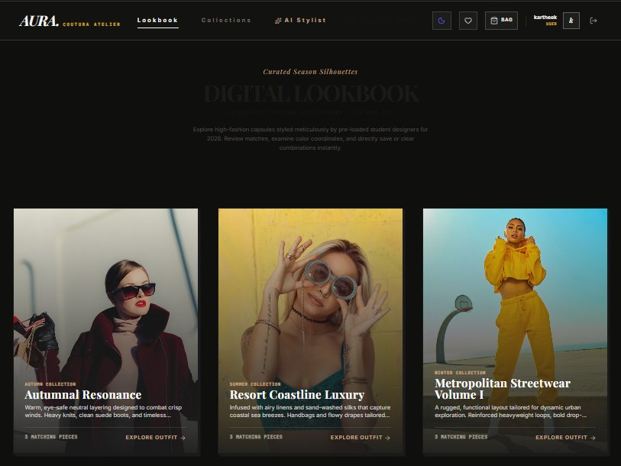
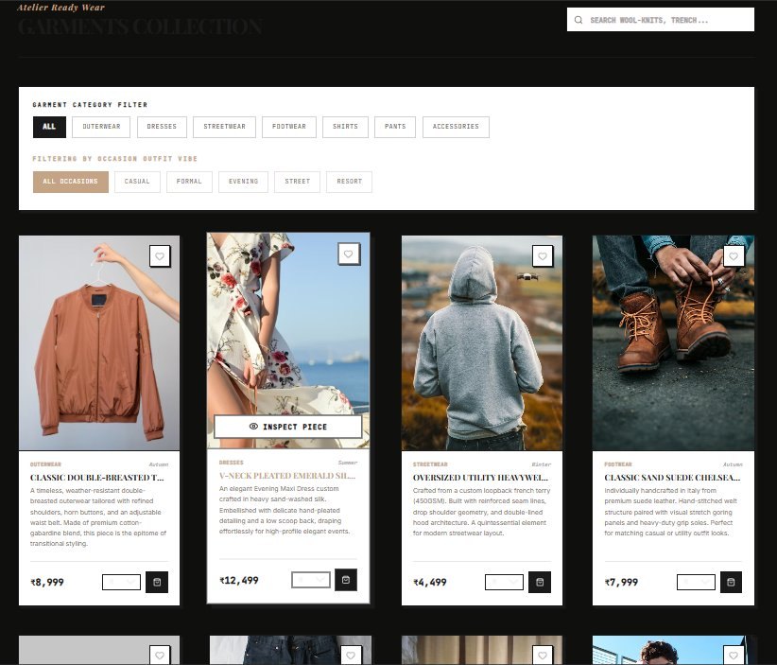
5.1 USER INTERFACE
App's UI Screenshots
Live preview of the React application’s key pages and interactions
Digital Lookbook Page
Garments Collection Page

Slide 11





5.1 USER INTERFACE & WORKFLOW
The Journey from Discovery to Checkout
01
02
03
04
DISCOVERY
SELECTION
MANAGEMENT
TRANSACTION
Browsing the curated fashion grid with real-time filtering by occasion and season.
Adding desired items to the personal wishlist or lookbook collection for future styling.
Organizing and visualizing outfit combinations within the personalized user dashboard.
Seamless checkout workflow with order summary and integrated payment interface.

Slide 12

6.1 PROJECT SUMMARY
Advancing Fashion Discovery
"Successfully bridging the gap between static inspiration and interactive digital management through a premium, responsive fashion platform."
INNOVATION
SCALABILITY
IMPACT
Digital Curation
Modular Architecture
Centralized Solution
Transformed traditional fashion browsing into a dynamic, user-led experience with real-time filtering and personalized lookbooks.
Developed a robust React-based foundation that allows for seamless future integration of AI-driven styling and social features.
Provided a sophisticated digital environment for modern enthusiasts to organize, visualize, and manage their unique style journeys.

Slide 13


6.2 KEY TECHNICAL LEARNINGS
Reflections & Future Directions
COMPONENT MASTERY
ARCHITECTURE DESIGN
The Future of Digital Style
Deepened understanding of React's lifecycle and state management for building highly interactive UIs.
Learned the critical importance of a clean, modular folder structure for long-term project scalability.
UI/UX FOCUS
FUTURE AI INTEGRATION
PROJECT COMPLETE
Prioritized the user journey and accessibility, ensuring a premium experience across all digital touchpoints.
Exploring machine learning models to provide personalized outfit recommendations based on user behavior.
THANK YOU FOR YOUR ATTENTION

